Slide 1

N
-CLOUD
A Cloud Base Log / Flow Analyzer
And Operation Platform
Robin
rshih@npartnertech.com
20150113

Slide 2
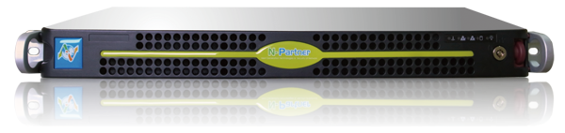
Syslog Collection
/Store/Analysis/Searching
Flow
(Netflow / sFlow) Analyzer
Real Time Abnormal Behavior Analysis
High Performance and Scalability
Reporting
N-Cloud is using cloud technology

Slide 3

Syslog Data storage/Query/Analysis
Support Syslog Collection of multi devices/Server
Artificial Log Analysis
Cloud Structure, fast log query, scalable storage space
Syslog Collection
/Store/Analysis/Searching

Slide 4







Supporting log collection for all brand of devices
Internet
Collect different log from all devices(Log)
  Security Syslog:
  IPS/IDS, UTM, WAF, NGFW, Wireless
  Flow:
  Netflow(v5/v9)/sFlow/Jflow
  Syslog Traffic:
  Firewall
  Server/Application:
    Web Server(Apache), AD, Database(Oracle, MSSQL), Server(Linux, Mail)…
Home
IPS/IDP
Security
Router
Firewall
Network
sFlow/NetFlow
Switch
Server
Server
Application
  Administrator can have all information and operation on one stop console.
Event Log
Flow Traffic
N-Cloud
Event Log
Flow Traffic

Slide 5
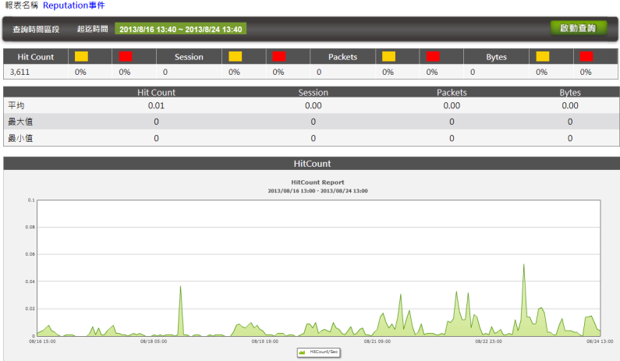
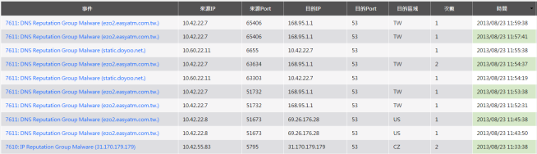
Use case-Botnet monitoring(event analysis from IPS)
23:00 huge
Botnet activities

Slide 6
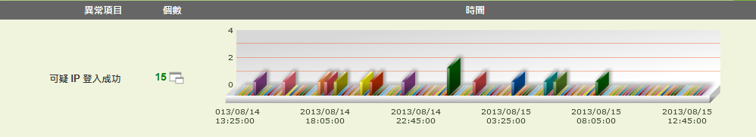
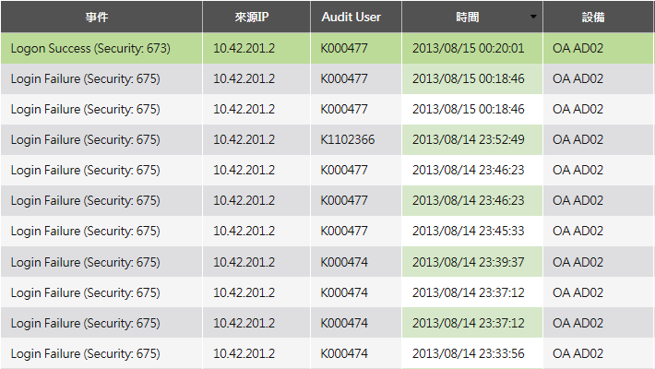
AD Authorization log collection
Detect a success login by brute force attack
Finally hacker login successfully
Continuous password guessing from a IP address.

Slide 7
Flow Analysis
Traffic analysis and Top N sorting
Flow analysis and monitoring for specified organization
Support Threshold configuration, threshold alert
Flow
(Netflow / sFlow) Analyzer

Slide 8
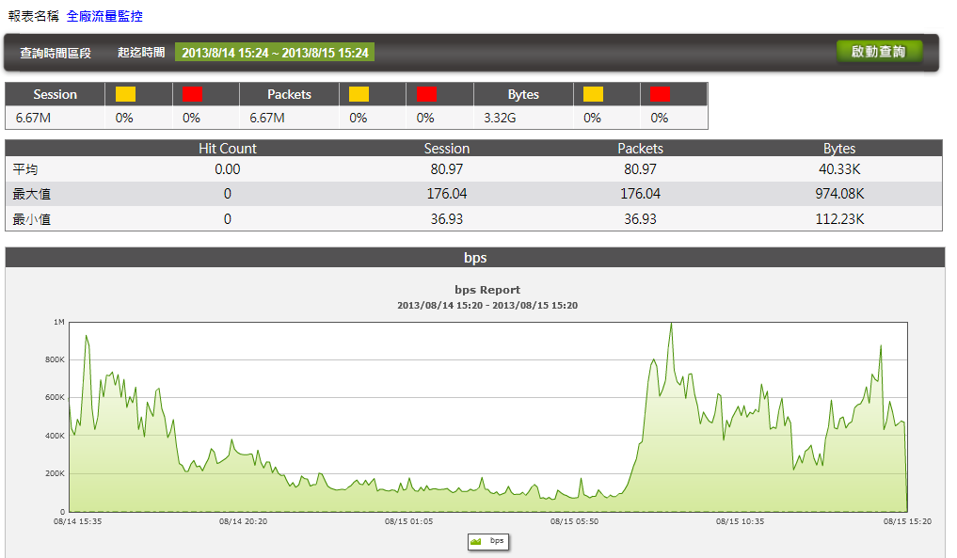
Organization (IP)monitoring

Slide 9
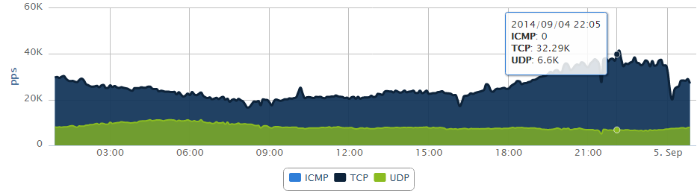
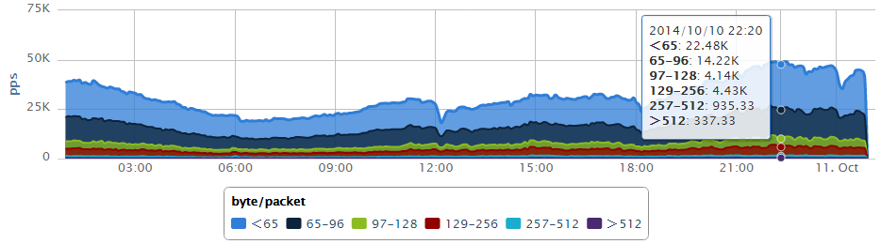
Packet size/byte and Protocol analysis- support network usage and debug

Slide 10
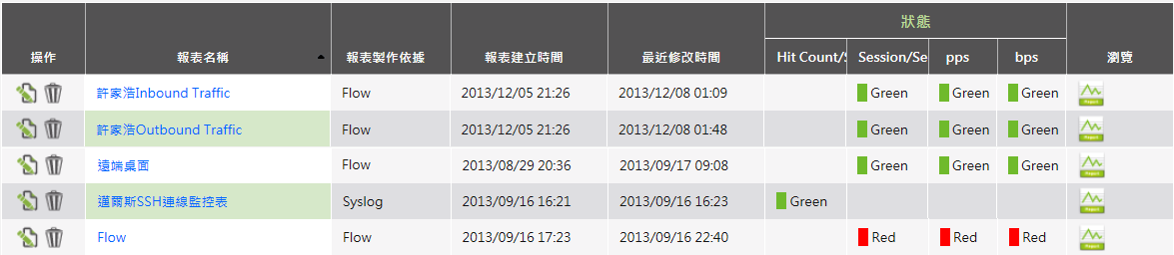
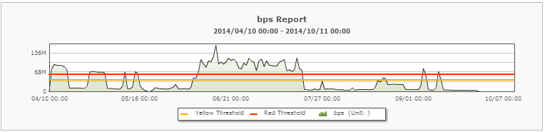
Abnormal real time alert for each department-
Sort out problem for unqualified network
Sales
TP Office
Marketing
IT
Manufacture

Slide 11
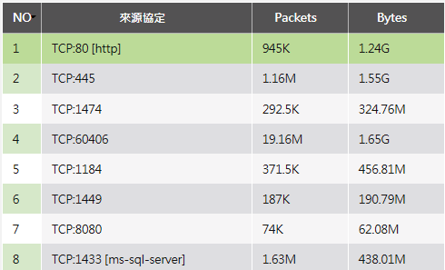
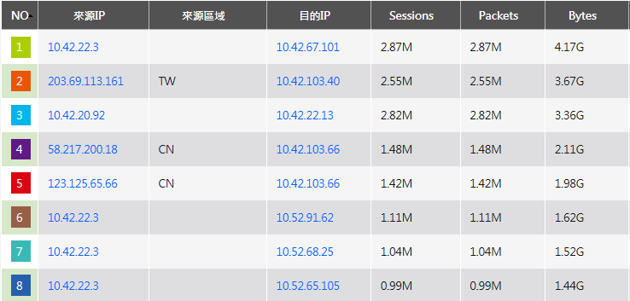
IP/Port TOPN
Drill Down for detail query

Slide 12
Abnormal real time trend analysis
Learn from history behavior Build up reasonable Base Line
Real Time Syslog Event alert Syslog/Flow abnormal behavior
Join defense –Stop abnormal behavior by FW/IPS/Switch/Wireless
Real Time Abnormal Behavior Analysis

Slide 13
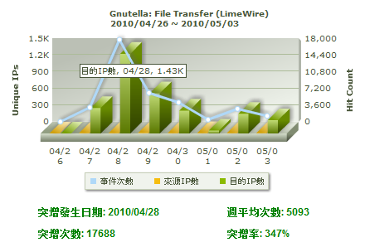
Trend Analysis provides brutal hit count increase information
Effective Base Line is established by historical data calculation by advance and accurate algorithm. Realtime abnormal event within one second to one minutes can be detected effectively and accurately
Abnormal event can be detected within 1 mins.
Abnormal event can be captured in the network without extra human power
This is a device possessing artificial intelligent Analyzer rather than a Reporter.

Slide 14

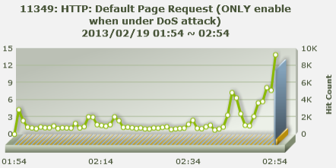
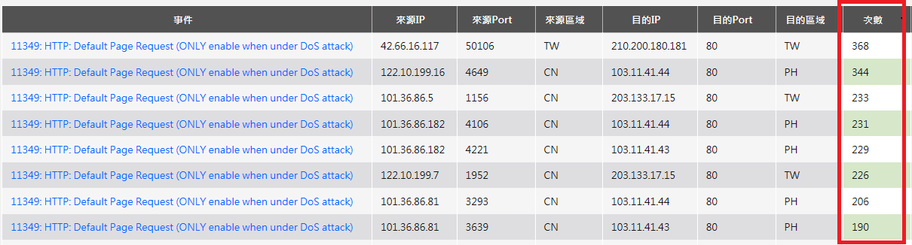
DDoS protection use case(Web attack)-
Realtime analysis report the source and stop the attack immediately
2/19 02:54 Abnormal
Melicious source
Victim Web site
Impossible default page retrieve 368 within one mins

Slide 15
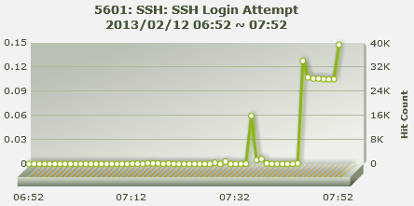
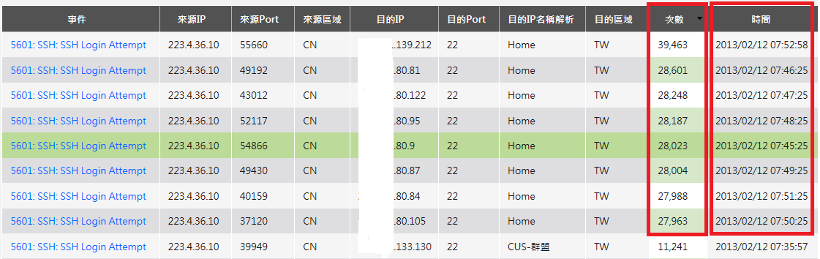
DDoS protection use case(ssh login attack)-
Realtime analysis report the source and stop the attack immediately
2/12 07:45
Abnormal increase
Large volumn of SSH login to multiple victims, crash the performance of firewall
Attack source
223.4.36.10
Large volumn of SSH login rqquest in a very short period

Slide 16
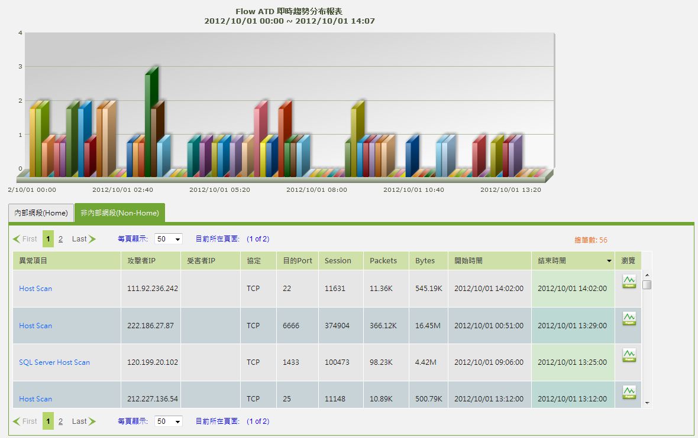
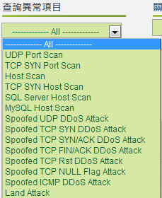
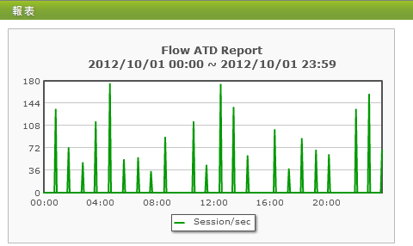
Flow realtime analysis-
advance tools for Ddos protection
Build in with large number of DDoS analysis algorithm based on NetFlow/sFlow data.

Slide 17
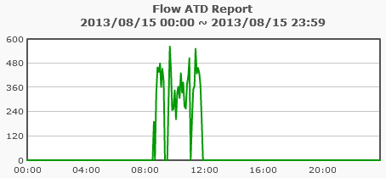
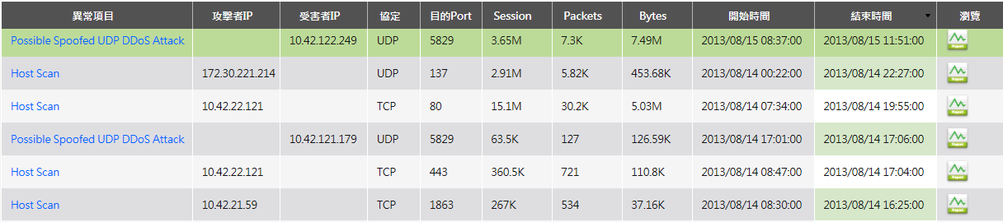
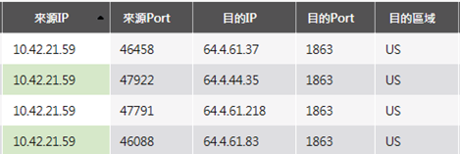
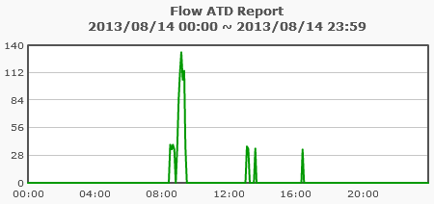
Auto learning of trend analysis
UDP Flooding and Host Scan example

Slide 18

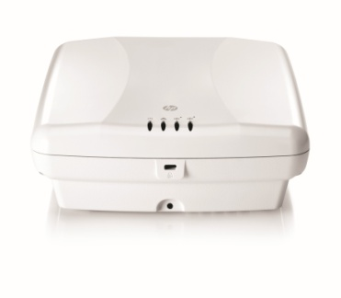
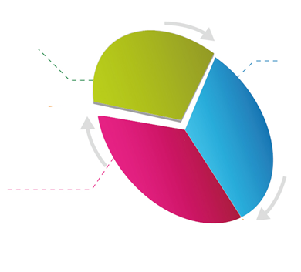



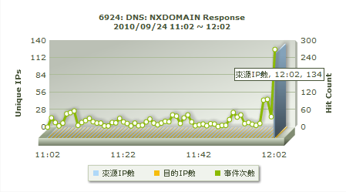

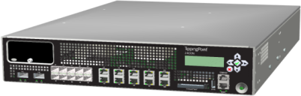
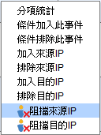

透過聯防機制,3-5分鐘內解決網路異常
Step 1
N-Cloud根據搜集到的資安事件與Flow資料建立歷史用量圖
根據歷史用量發現任何異常突增即時告警
Syslog/Flow Export
N-Cloud
DDoS Attackers
Attacker 1
Attacker 2
Attacker 3
Internet
Abnormal Behavior
Auto-Learning , Auto-Detection
and
Action
IPS
Step 2
IT Administrator收到異常突增告警後確認攻擊來源,下達封阻指令到IPS/FW/Switch/Wireless等聯防設備
DNS
FW
Web Portal

Slide 19



Resolve abnormal behavior within 3 mins
by collaborate defense
Step 1
Historical security data is build by N-Cloud from the collected syslog data and flow data
Alert is triggered based on the analyzed historical data
log
N-Cloud
Syslog/Flow Export
Block
N-Cloud
DDoS Attackers
Attacker 1
Attacker 2
Attacker 3
Step 2
IT Administrator can issue the blocking command to IPS/FW/Switch/Wireless devices by a click after confirmation of the alert send by Ncloud
Support Auto blocking
Internet
Abnormal Behavior
Auto-Learning ,
Auto-Detection and Action
IPS
Web Portal
FW
Switch
DNS

Slide 20
Reporting
Exclusive report for specified Domain Administrator
Report Auto generation and off-line delivery
Support AD Name Mapping
Reporting

Slide 21
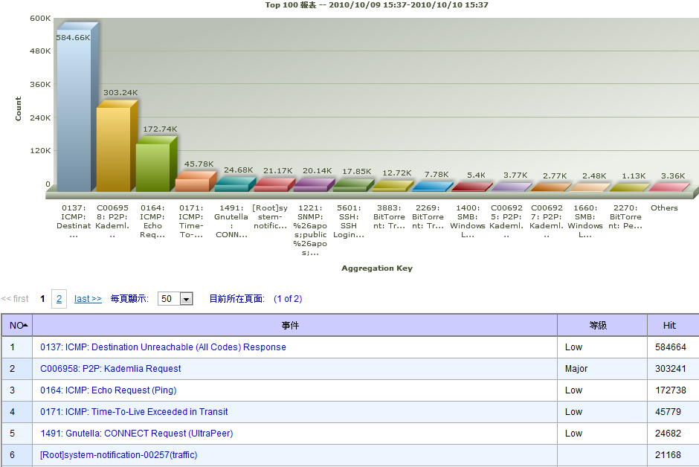
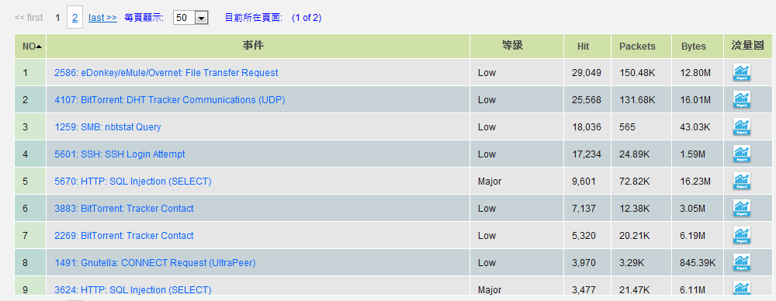
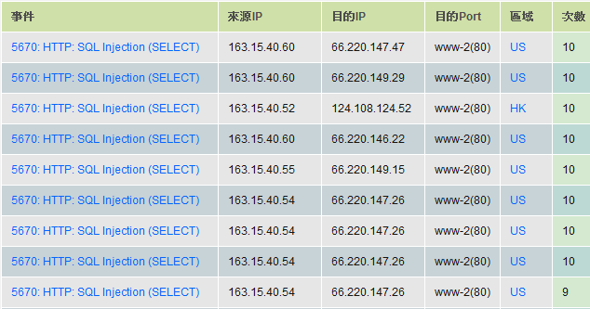
Define exclusive report
Support multi logic query
Drill down for detail event in TOP N report
Detail event query from TOP N

Slide 22
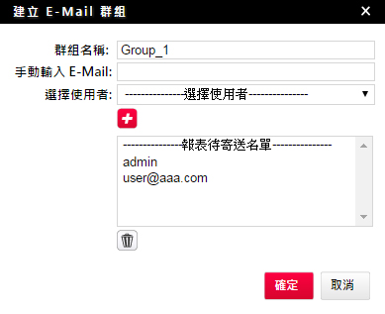



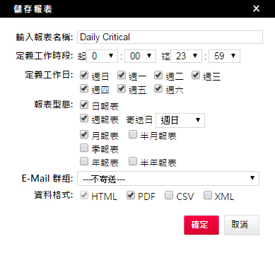
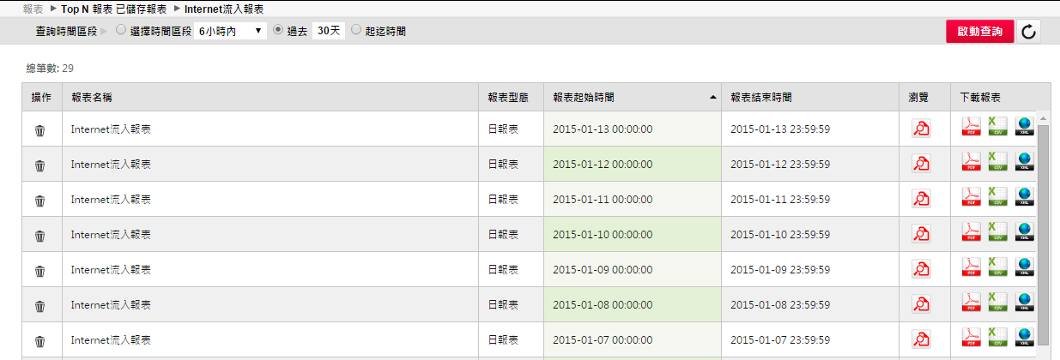
Report Auto generation and deliver to specify user
Report auto generate schedule and deliver
Specify receiver
Define working hours or days
Daily/Weekly/Bi-Weekly/Monthly/Quarterly/Bi-Quarterly/Yearly Report
Historical Report storage and query
Support Multi export format
Support Multi Export format

Slide 23
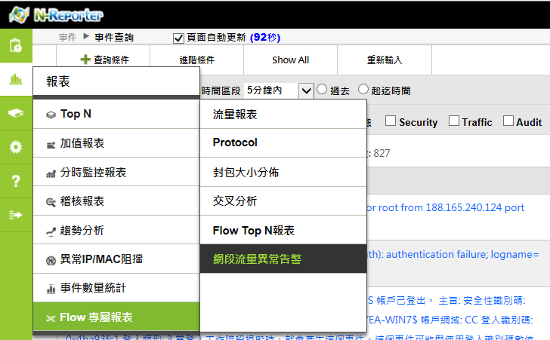
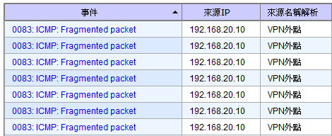
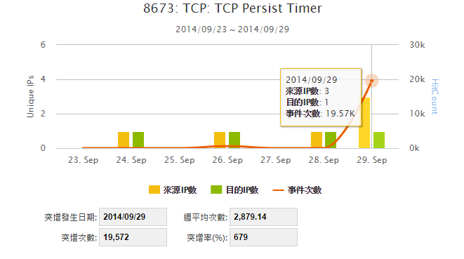

User friendly interface
Support AD name mapping
使用名稱呈現
使用名稱呈現
Support Mouse tail Tips

Slide 24
Cloud Technology
2-tiers (Global View and Individual Domain)
High Availability and Pay-by-grow Extension
Multiple users operation
Google like searching performance
High Performance and Scalability

Slide 25


N-Cloud Structure
Internet
HA
Public IP
N-Load Balancer
提供負戴平衡和N-Cloud健康異常偵測
Private IP
HA
N-Center
提供Web介面和Reporting
HA
N-Receiver
提供資料收集儲存和即時異常分析

Slide 26
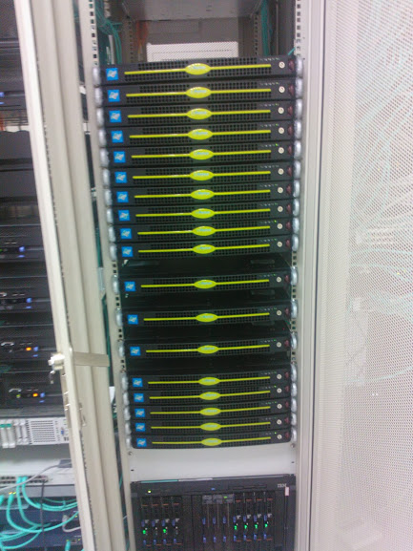
Real deployment case
Background
  Industry Sector: Government/Education Center
  Total number of users: Over 320,000
  Internet Bandwidth Usage: Over 7Gbps
  Subsidiary: 1 Center, 400 Schools, 50 Admin Organizations, Server Farm
  IT Administrator: Over 500 (Access N-Cloud at the same time)
  Syslog/Flow Devices number: Over 700
  Syslog EPS: Up to 40,000 event per second
  Flow Record: Up to 30,000 record per second
  Raw Data Require Storage Space: At least 5 Years
  N-Cloud Devices : 16x1U Servers

Slide 27



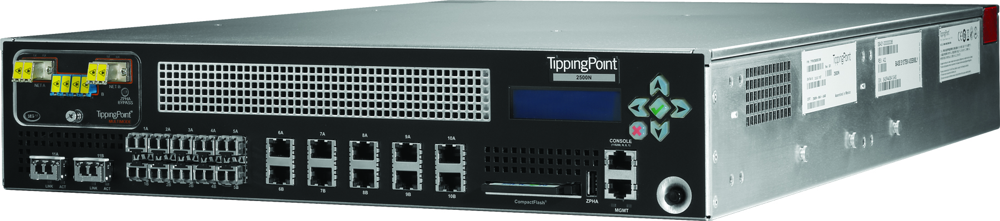















N-Cloud
-Central Operation
-Security Response
-Reporting
Internet
GE x 7
Government Org
HP 5120 L2 Switch
International Access
TP S5100 IPS
Botnet/Attack
App Control
Zero Day/Exploit
HP 6604 Router
Check Point
SWG 12600
-Web Filter
Remote Site
TP S2500 IPS
Data Protect
Zero Day/Exploit
Wireless Network
HP10508
Core Switch
Sophos
Anti-Virus
Malware0
PC Classroom
10G *2
TP 2400
10G *2
Research Center
NS 5400
Firewall
10G *6
SRX 550
Firewall
S High School
Cellopoint
- Mail Filter
Server Farm
Virtual FW
SRX 550
Firewall
J High School
Juniper NS5400
Firewall
10G *6
10G *X
E-Learning
SRX 240
Firewall
Primary School
HP 5900 L2 Switch
1G *50
Leased Line
Small Primary School
Virtual Firewall

Slide 28
Internet
N-Cloud
-Central Operation
-Security Response
-Reporting
GE x 7
Government Org
HP 5120 L2 Switch
International Access
TP S5100 IPS
Botnet/Attack
App Control
Zero Day/Exploit
HP 6604 Router
Check Point
SWG 12600
-Web Filter
Remote Site
TP S2500 IPS
Data Protect
Zero Day/Exploit
Wireless Network
HP10508
Core Switch
Sophos
Anti-Virus
Malware0
PC Classroom
10G *2
TP 2400
10G *2
Research Center
NS 5400
Firewall
10G *6
SRX 550
Firewall
S High School
Cellopoint
- Mail Filter
Server Farm
Virtual FW
SRX 550
Firewall
J High School
Juniper NS5400
Firewall
10G *6
10G *X
E-Learning
SRX 240
Firewall
Primary School
HP 5900 L2 Switch
1G *50
Leased Line
Small Primary School
Virtual Firewall

Slide 29
Private Cloud
Big Enterprise/university/Government/regional company
public cloud
telecom MSSP/SI cloud business
N-Cloud Commercial deployment

Slide 30
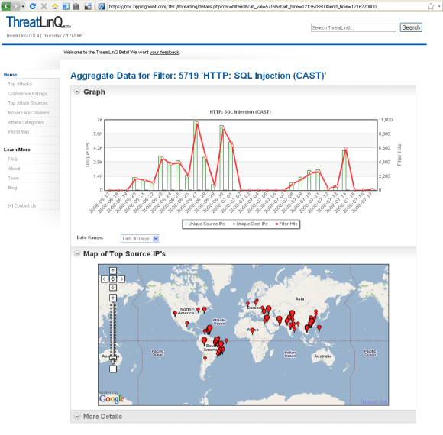

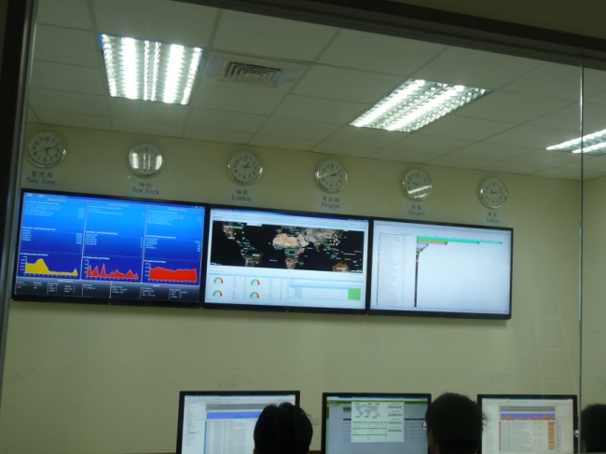

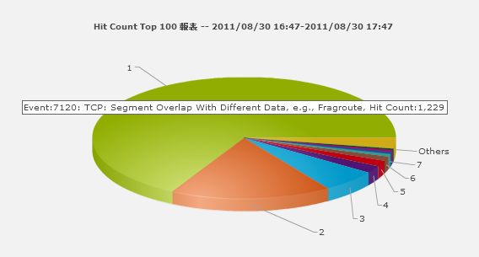
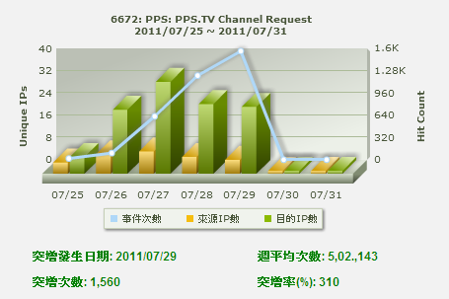
私有雲運用-跨廠區,校區或是跨組織的資訊搜集
Internet
→全域Syslog/Flow集中搜集
→中央端可進行全域統合分析(Global View)
→各分區(Domain)僅查閱自己的Syslog/Flow
Event Log
NetFlow / sFlow
→掌握異常,即時處置
臺灣總部
N-Cloud
大陸廠區
Event Log
NetFlow / sFlow
Event Log
NetFlow / sFlow
歐洲
分公司
美國
研發中心
Event Log
NetFlow / sFlow

Slide 31




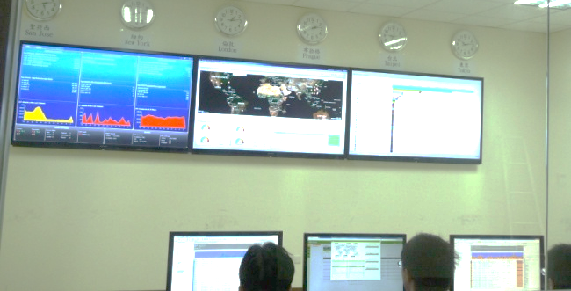
Private Cloud-
Regional Factories/office, campus or regional organization
Entire Domain Syslog/Flow Collection
Global analysis for all Domain (Global View)
Each Domain only view it’s own Syslog/Flow
Immediately resolve abnormal behavior
美國研發中心
N-Receiver mini
台灣總部
歐洲
分公司
IPS
Core Router
Internet
N-Cloud
大陸廠區
Traffic log /Flow and Syslog
Traffic
DDos

Slide 32
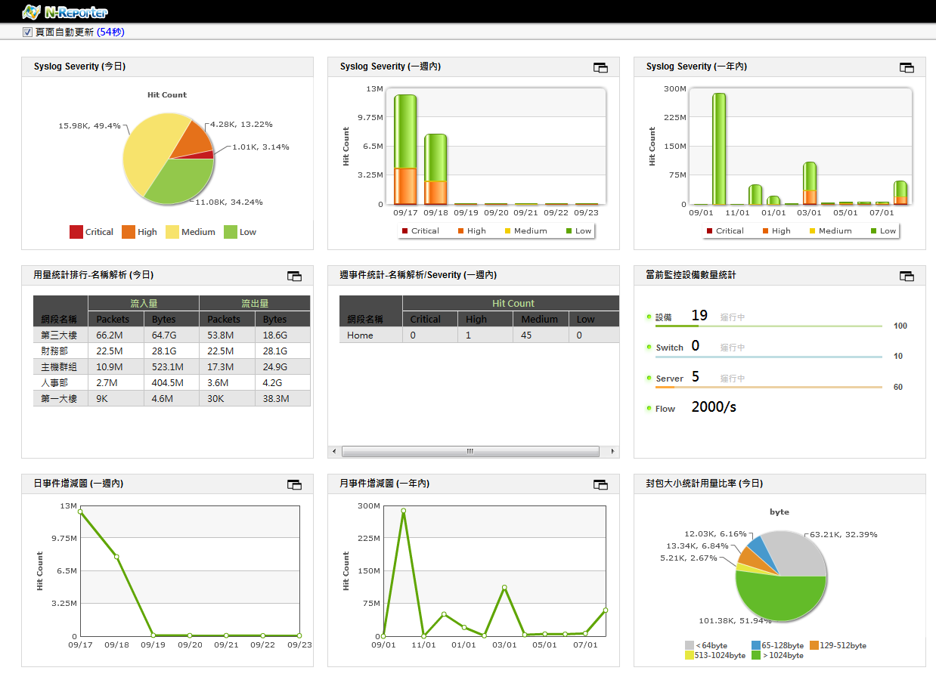
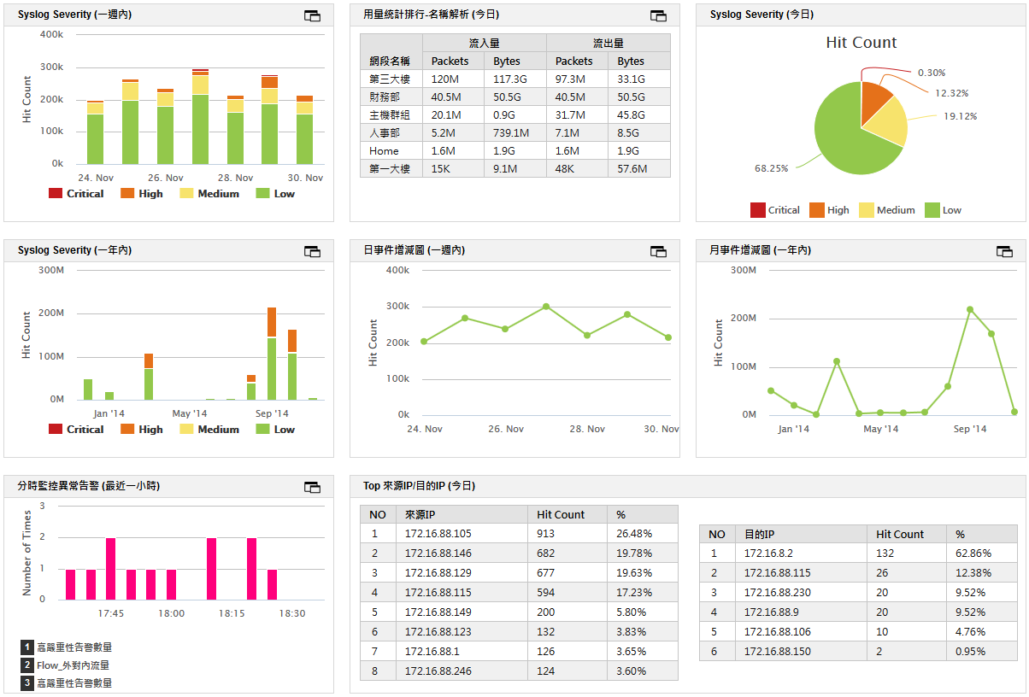
New generation IT operation platform-
CIO point of view, holistic approach
Professional SOC monitoring Dashboard
Drill-Down for detail query
User Defined Dashboard
N-Cloud Analysis Display

Slide 33




N-Cloud 軟硬體整合方案(1/3)
公有雲運用-電信的MSSP生意(安全加值服務)
Trojan
DDoS
Virus
安全服務 (如: IPS, DDoS, Anti-Virus, APT…)–
電信佈署安全設備於Internet出口端,分享給購買安全服務的使用者
還可以提供NetFlow訊息與使用分析情報給用戶
Log上傳保存與分析服務-
用戶可以上傳Log與Flow
N-Cloud –
搜集所有Log/Flow資料後依據IP地址分發給所屬用戶
每個用戶都有一個專屬網頁
Internet
Customer B
Customer A
Customer C
Customer B
IPS
Core Router
Customer A安全事件
Syslog
Flow Traffic
Telecom Core
Customer A
N-Cloud
Customer B
Customer C
Customer A
Leased Line/ADSL
Customer A
Customer C流量資訊
Syslog
Flow Traffic
IDC
Syslog
Flow Traffic
Customer B
Customer C
Syslog
Flow Traffic

Slide 34
Public Cloud-
Telecom MSSP Business(Add value Security Service)
Security Service (IPS, DDoS, Anti-Virus, APT…)
Providing Security Service to Users by deploying security products, such as IPS, Firewall etc. along side of the Netflow information and analysis result
Log upload archive and analysis
User can upload the syslog log and flow log
N-Cloud
Collect Log / Flow data and distribute to each Ncloud user Each user has his/her own portal
DDoS
Trojan
Virus
Internet
Customer B
Customer A
Customer C
Customer B
IPS
Core Router
Customer A安全事件
Syslog
Flow Traffic
Telecom Core
Customer A
N-Cloud
Customer B
Customer C
Customer A
Leased Line/ADSL
Customer A
Customer C流量資訊
Syslog
Flow Traffic
Syslog
Flow Traffic
IDC
Customer B
Customer C
Syslog
Flow Traffic

Slide 35
Public Cloud- IT Device Reseller/SI Cloud Business
Unique
Support high qualify Post Sales service, real time status monitoring offering user a advance support service
Remotely debug according to realtime alert. Reduce operation cost and human power.
Solve the problem in short period of time.
N-Cloud
Every user has his/her own portal
IT device reseller /SI build
N-Cloud in IDC
N-Cloud
SI A
Internet
Enterprise A
Internet
Collect log form sold devices
Policy Tuning
User can view report on their own portal
Collect log form sold devices
Policy Tuning
User can view report on their own portal
Internet
SI B
Enterprise B
Enterprise C
Collect log form sold devices
Policy Tuning
User can view report on their own portal

Slide 36

Public Cloud-
IT devices reseller operate internet access control business
Service Description–
Internet Access Control and Monitoring is always a vital requirement for the majority enterprises
By the traditional IT business channel
Traditional IT devices selling (User Internet Access devices)+Cloud Service(N-Cloud)
N-Cloud provides easy configuration method and analysis report
User can user easily without professional IT staff
Reduce the operation cost
Suitable for all service provider
N-Cloud build in IDC
Manage the user device via Internet
N-Cloud
Internet
China Telecom Boardband
Enterprise A
Block Command
Internet
Internet
Unicom/Mobile/Metropolis user
攔阻設定
Enterprise B
Enterprise C
Block Command

Slide 37
END

